Slide 1
SK MART CUSTOMER ANALYSIS
Detailed report

Slide 2
Analysis Questions
What is the total sales?
What is the total profit after discount?
What is the sales quarterwise?
Which payment mode is preferred the most by the customers?
Which channel is contributing the most sales?
Which category is contributing the most profit?
Which region make the most sales?
Etc…

Slide 3
INSIGHTS
Store make the 30,592,560.50 of sales with the total profit of 6,546,998.49
The west region contributed the most net sales among all region.
Customer prefer both channel equally with 50% online and offline both equally.
We can see a slight down trend on sales quarter wise with q1 with the most sales.
Among all category home decor has contributed the most profit, then after that beauty, clothing, electronics.
Customer preferred the payment mode equally with 25% each in cash,card,upi, and wallet.
Delivery status has seen 25% each in delivered,cancelled,in-transit,returned.

Slide 4
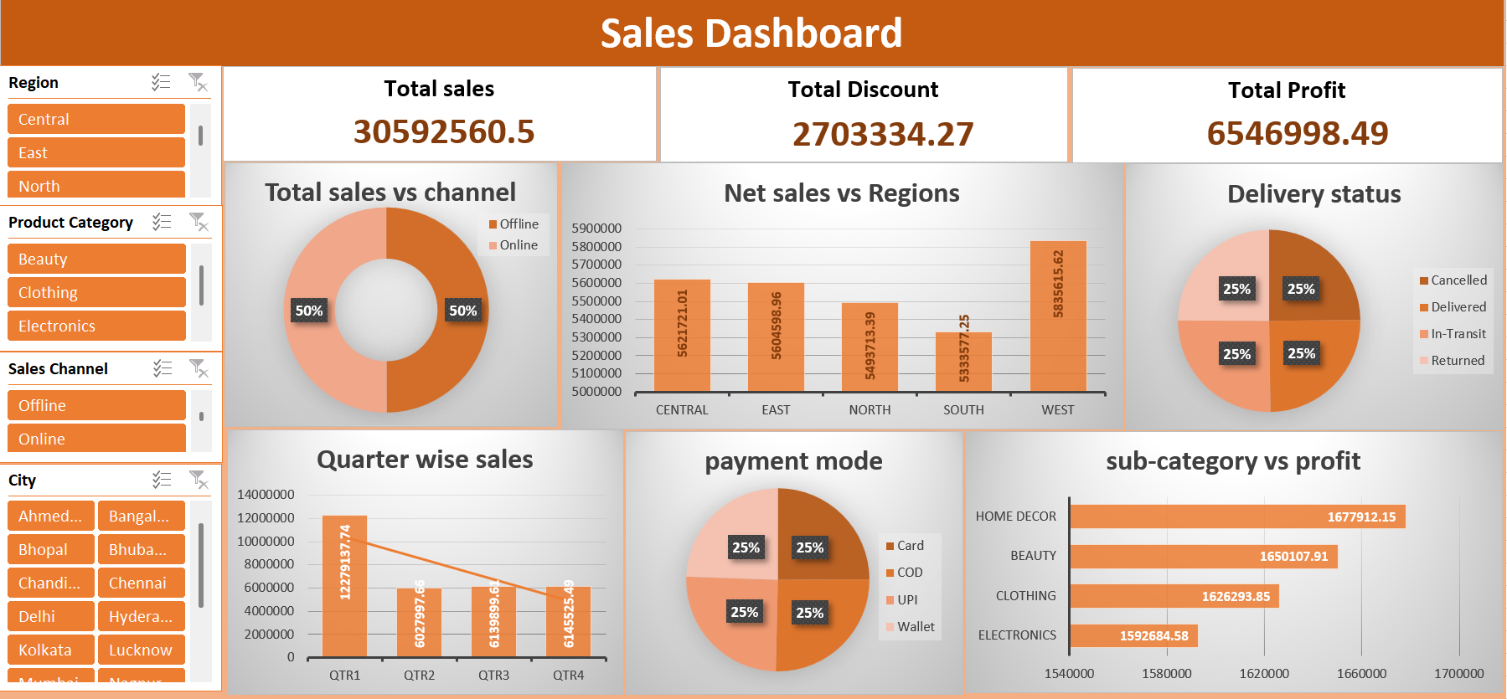

Slide 5
Recommendations for business
1. Focus on High-Performing Regions
West region leads in net sales. Consider allocating more marketing budget and inventory to this region to capitalize on demand.
2. Optimize Channel Strategy
With 50% of customers preferring both online and offline channels, maintain a balanced omnichannel presence.
Invest in seamless integration between online and offline experiences to boost customer satisfaction.

Slide 6
Recommendation
3. Address Quarterly Sales Decline
Q1 shows peak sales, followed by a gradual decline. Launch seasonal campaigns and promotions in Q2–Q4 to stabilize revenue flow.
4. Prioritize Profitable Categories
Home Decor is the top profit-generating category, followed by Beauty, Clothing, and Electronics.
Expand product range and marketing efforts in these categories to maximize profitability

Slide 7
Recommendation
5. Diversify Payment Experience
Customers show equal preference (25%) for Cash, Card, UPI, and Wallet.
Continue supporting all payment modes and explore loyalty programs linked to digital payments.
6. Improve Delivery Outcomes
Delivery statuses are evenly split across Delivered, Cancelled, In-Transit, and Returned.
Investigate reasons for cancellations and returns to reduce losses and improve customer experience.

Slide 8
Thank you

